Slide 1


CSS 497 CAPSTONE PROJECT
FAKE TWEETS IDENTIFIER
Tommy Tang
Project Instructor: Dr. Min Chen

Slide 2
Part 1
Introduction
Part 2
Project Objective
AGENDA
Part 3
Related Works
Part 4
Solution

Slide 3
Part 5
Design Architecture
Part 6
Demo
AGENDA
Part 7
Conclusion
Part 8
Future Work

Slide 4
1
Introduction

Slide 5
Introduction
Social Media
Industries
Influential -> youth, business, politics
“Freedom of Speech”
Companies apply advertising approaches on social media to influence people
Build product reputation
Credibility
General Public
Fake news / tweets
Impact how people think
Eg. 2016 Elections

Slide 6
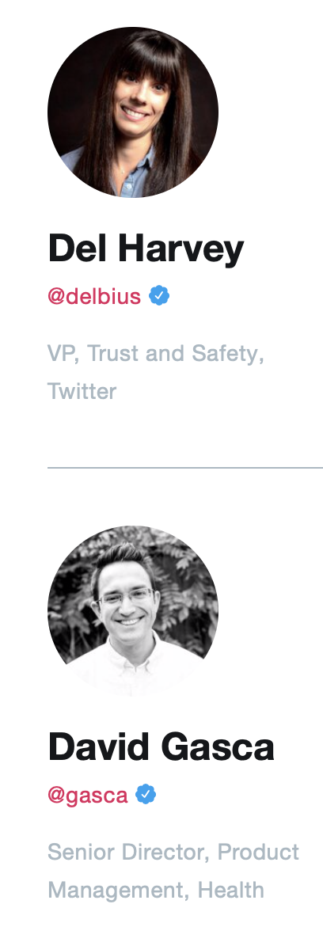
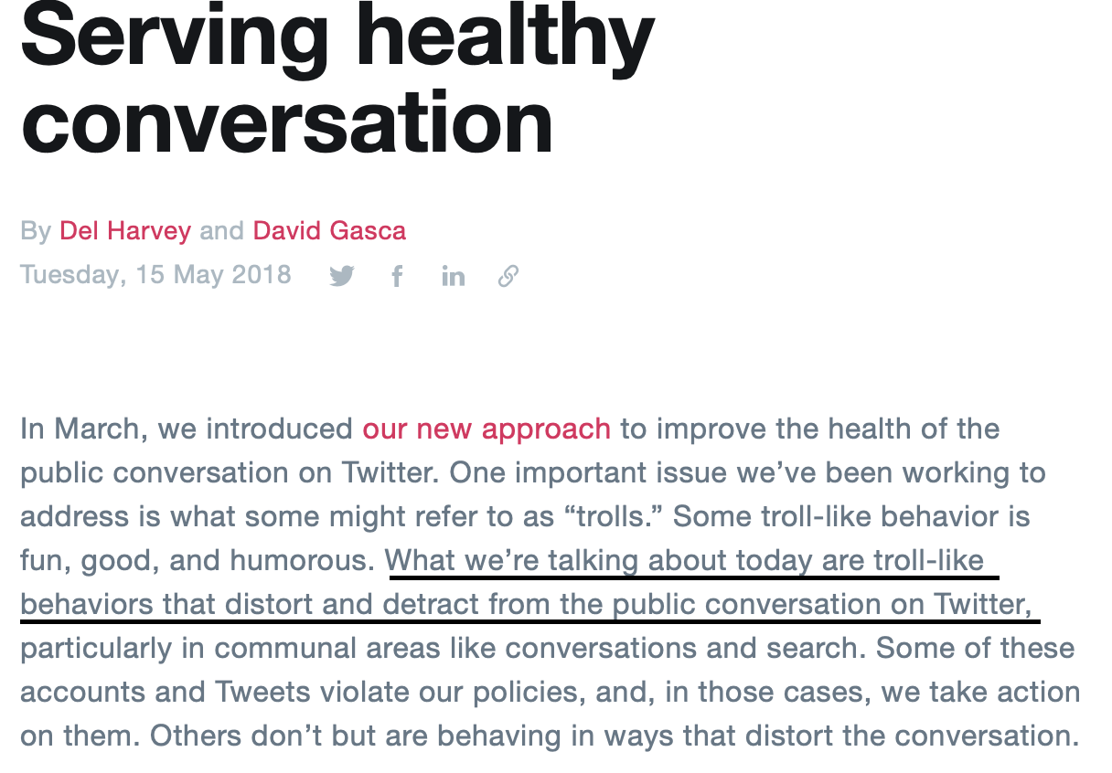
Introduction

Slide 7
2
Project Objective

Slide 8
The objective of the project is to present an Android App that identifies fake tweets for users based on some given backend design and implementations

Slide 9
3
Relared Works

Slide 10
Related Works
Saez-Trumper, D. [1] has created a system called ”Fake Tweet Buster”
Gupta, A., and Kumaraguru, P [2] studied the role of twitter during Hurricane Sandy(2012).
Castillo, C., Mendoza, M., and Poblete, B. [3] studied challenges of computational verification in social multimedia

Slide 11
Related Works
Based on study…
No robust framework to predict a tweet’s credibility
No experimentations on miscellaneous events
No experimentations based on a tweet’s image or URL credibility

Slide 12
4
Solution

Slide 13
Solution
To build a system which verifies the credibility of a tweet
Machine Learning Model
Android Application for Users to Interact
Dynamic Generated Report to help the app to improve

Slide 14

Solution
Tweet
Machine Learning
Model
Android
App
Fake Or Real

Slide 15
Solution
Machine Learning Model
Features
Content Features
isUrlCredible | noOfExclamationMark
isImageCredible | containsQuestionMark
sentimentScore | containsExcalmationMark
tweetLength | noOfUpperCaseLetter
wordCount | noOfhasgTags
noOfQuestionMark | noOfUrls
noOfRetweets
Algorithm
Tweets Feed
J48
SVM
Model
User Features
noOfFriends | isUserHasURL
noOfFollowers | isVerifiedUser
friendFollowerRatio | noOfTweets
noOfTimesListed

Slide 16


Solution
Feature Vectors
Megan Risdal Kaggle Dataset
isUrlCredible
Python Web Service
Sentiment Analysis
Google Reverse Image Search
Is Timeline aligned?
Is best guess related?
Are pages that contains the image reliable?
isImageCredible

Slide 17
Solution
Feature Vectors
All other features
Content Features
tweetLength | noOfExclamationMark
wordCount | containsQuestionMark
noOfQuestionMark | containsExcalmationMark
noOfRetweets | noOfUpperCaseLetter
noOfhasgTags | noOfUrls
https://api.twitter.com/1.1/statuses/show.json?id=210462857140252672
Twitter API
JSON response
User Features
noOfFriends | isUserHasURL
noOfFollowers | isVerifiedUser
friendFollowerRatio | noOfTweets
noOfTimesListed

Slide 18

Solution
Android Front-end
Amazon EC2 + Amazon RDS
Fake or Real
Tomcat
Tweet
Spring MVC
Android
Model

Slide 19
5
Design Architecture

Slide 20
Design Architecture
High Level Architecture
Low Level Architecture
Core (backend)
Android (Frontend)
Deployment Architecture

Slide 21


Design Architecture
High Level Architecture
Android
CORE
CONTROLLER
Tweet ID
Tweet ID
Tweet JSON
TWEET CONTENT FETCHER
Tweet JSON
Tweet
URLs
Tweet JSON
EXPERIMENT RUNNER
Android App
Feature set
FEATURE SET CREATOR
Tweet JSON
Record poll
User Guess
Feature set
Feature set
Show poll
Prediction
END USER
Prediction
Tweet Details
Crowd Sourcing Details
CROWD SOURCING
STORAGE
MANAGER
Feature set
MODEL
CLASSIFIER
Model
Evaluation Results
REPORT GENERATOR
Amazon RDS MySQL

Slide 22
Design Architecture
Low Level Architecture – Core (Backend)
EXPERIMENT RUNNER
Model, Evaluations
WEKA
Tweet ID’s
EXPERIMENT ORCHESTRATOR
J48 EVALUATION
ORCHESTRATE EXPERIMENT
Model,
Evaluations
Model
Tweet ID’s
Tweet
JSON
SVM EVALUATION
SERIALIZE MODEL
Feature set
TWEET CONTENT FETCHER
FEATURE SET
CREATOR
Evaluations
Tweet JSON
Tweet JSON
GENERATE REPORT
Updated Featurevector
Tweet JSON
Updated Featurevector
Tweet JSON
Updated Featurevector
Updated Featurevector
Update and Generate PDF
LABEL UPDATER
CONTENT UPDATER
SENTIMENT SCORE UPDATER
USER FEATURE
UPDATER
Generate J48 model
J48 MODEL
Generate SVM model
Sentiment score
-1 +1
Tweet body text
REPORT GENERATOR
SVM MODEL

Slide 23
Design Architecture
Low Level Architecture – Android (Frontend)
Tweet ID
user guess
HANDLE MAPPING
CROWDSOURCING
END USER
REST CONTROLLER
HTTP request
DISPATCHER SERVLET
(WEB.XML)
PARSE TWEET ID FROM TWEET URL
HTTP response
Tweet ID
user guess
Tweet ID
CORE
CONSTRUCT FEATURE SET
AJAX XHTTP request
Feature set
Callback JSON response
PREDICT CLASS FROM MODEL
Feature set
REPORT GENERATOR
Pass view
MODEL
Prediction
GET CROWD SOURCING DETAIL
Tweet ID
AWS SDK
Client
STORAGE MANAGER
AWS RDS MySQL
Crowd sourcing details
Tweet details, prediction, fake & real count
MODEL & VIEW
Tweet ID, fake count, real count

Slide 24
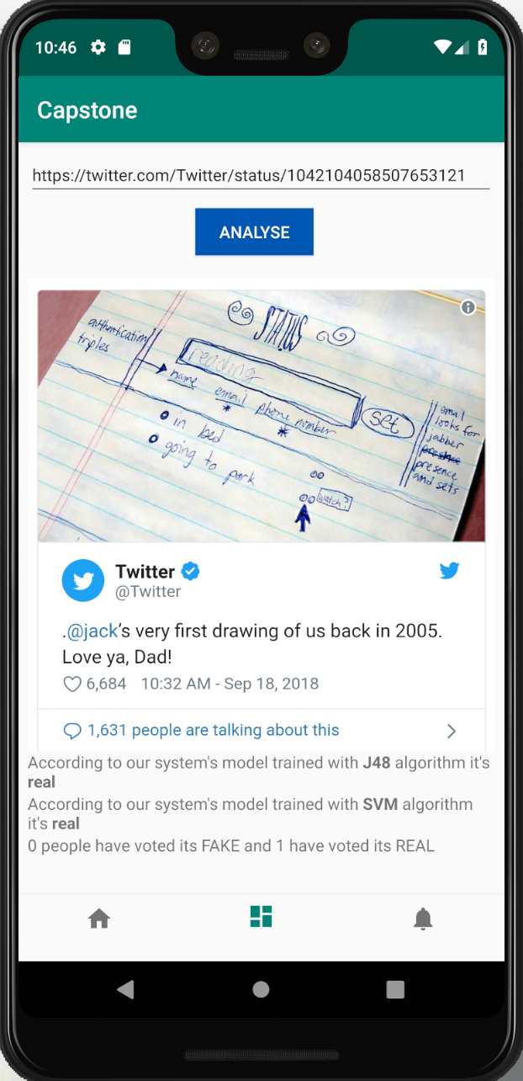


Design Architecture
Tools and Deployment
01
Implementation
Emulation
05
Transition
02
03
04
Deployment
Hosting
AMAZON EC2
Stop Tomcat
Start Tomcat

Slide 25
6
DEMO

Slide 26
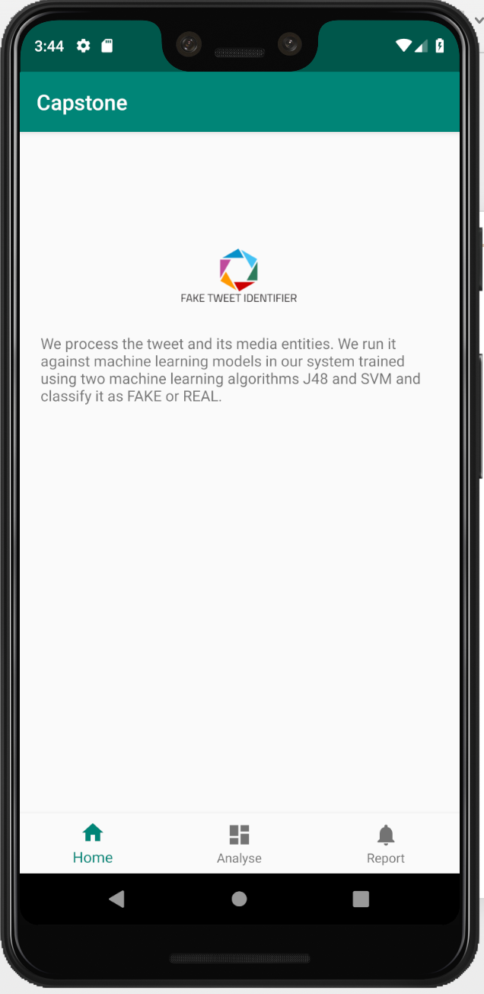
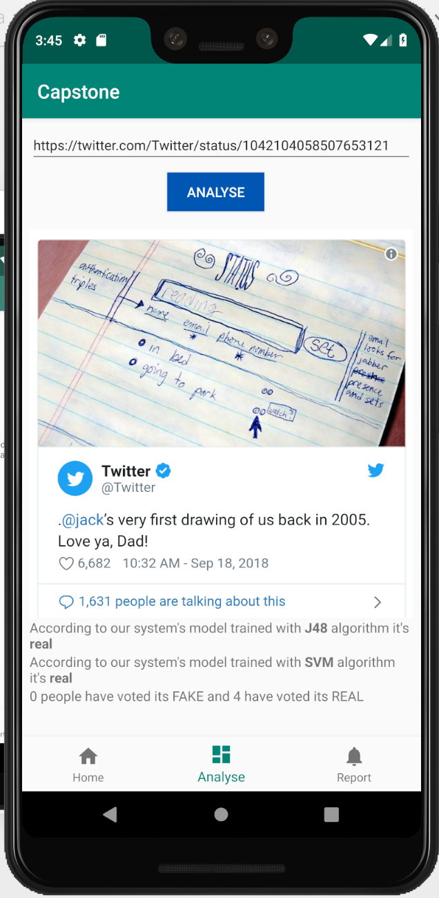
Demo

Slide 27
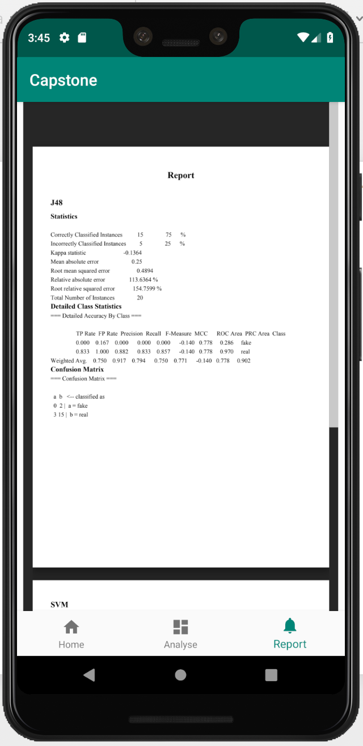
Demo

Slide 28
7
Conclusion

Slide 29
Conclusion

Slide 30
8
Future Work

Slide 31
Future Work
Feed in Various Datasets
Language Restriction
Automate Deployment
Enable Video Analysis
Platforms

Slide 32
REFERENCES
LOGO
Saez-Trumper, D. has created a system called ”Fake Tweet Buster”
Gupta, A., and Kumaraguru, P. studied the role of twitter during Hurricane Sandy(2012).
Castillo, C., Mendoza, M., and Poblete, B. studied challenges of computational verification in social multimedia

Slide 33
LOGO
Questions?

Slide 34
LOGO
THANK
YOU

